Slide 1
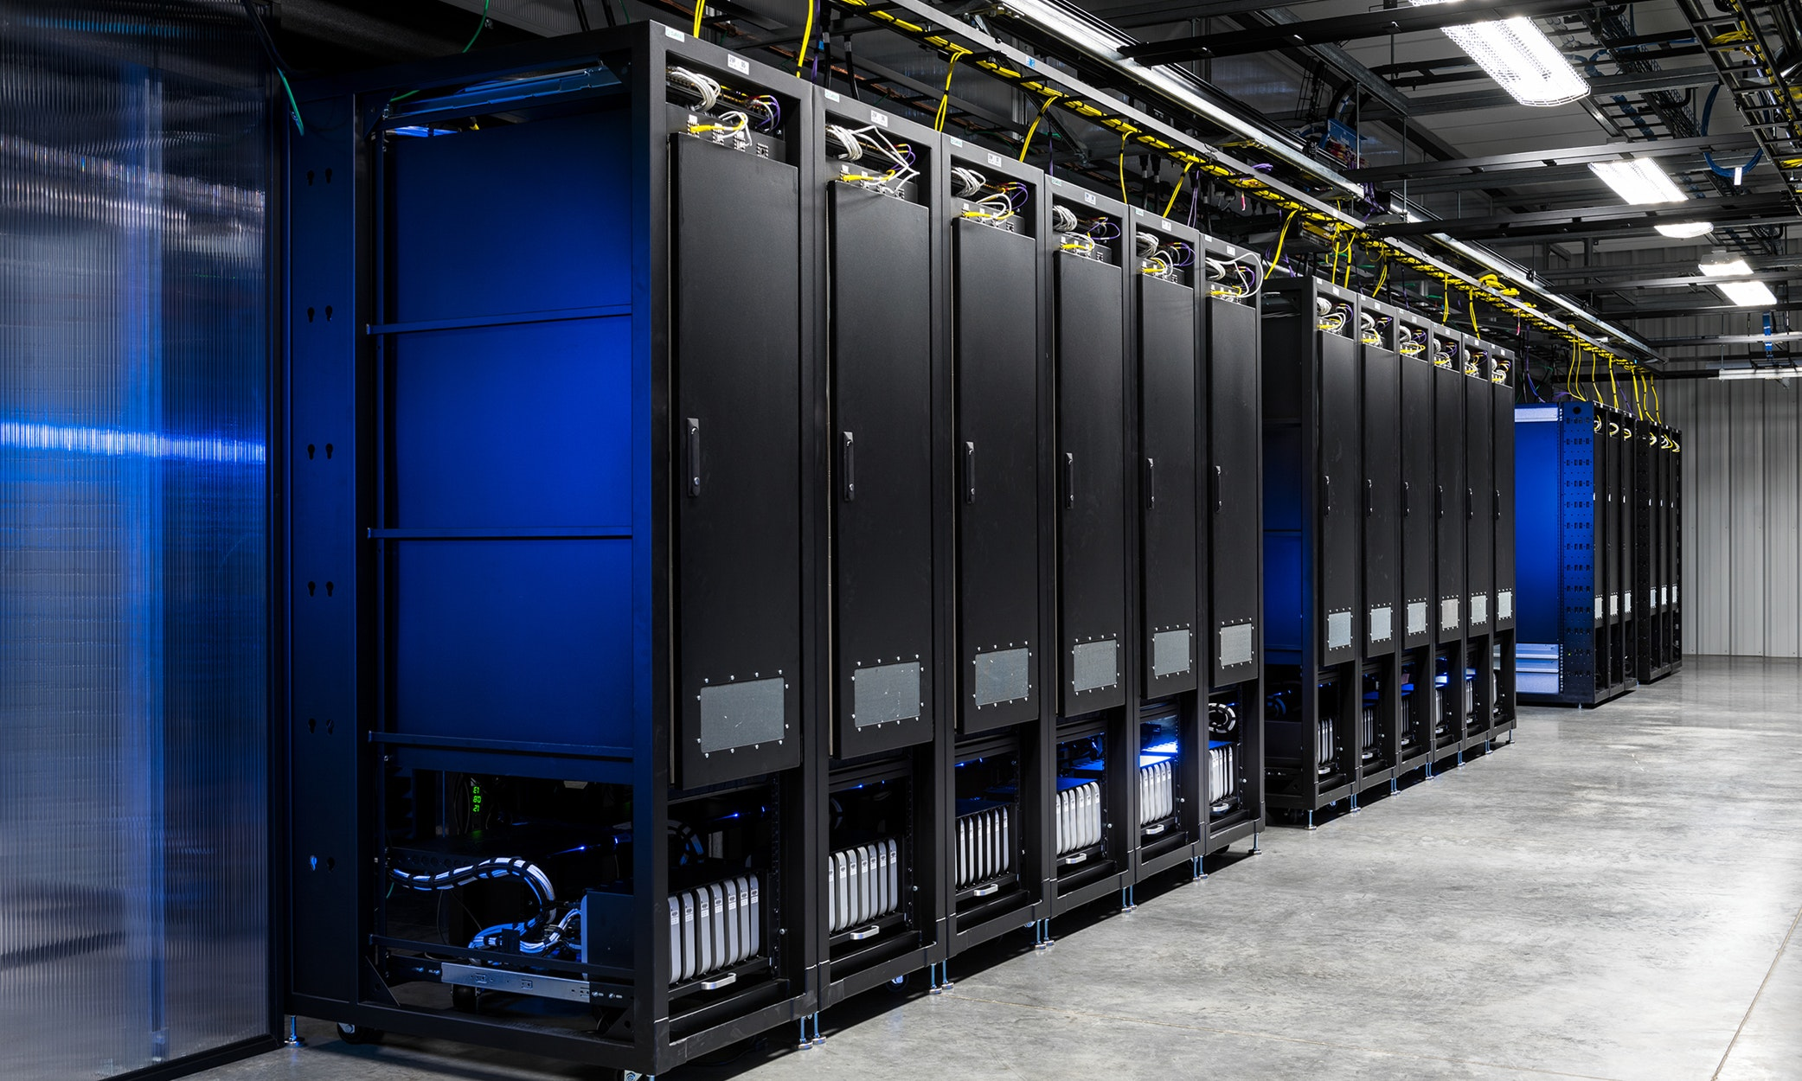
DE-ZOOMCAMP WEEK 3

Slide 2
Online Analytical Process (OLAP) vs. Online Transaction Process (OLTP)
 | OLTP | OLAP
Purpose | Control and run essential business operations in real time | Plan, solve problems, support decisions, discover hidden insights
Data updates | Short, fast updates initiated by user | Data periodically refreshed with scheduled, long-running batch jobs
Database design | Normalized databases for efficiency | Denormalized databases for analysis
Space requirements | Generally small if historical data is archived | Generally large due to aggregating large datasets

Slide 3
Cont…
 | OLTP | OLAP
Backup and recovery | Regular backups required to ensure business continuity and meet legal and governance requirements | Lost data can be reloaded from OLTP database as needed in lieu of regular backups
Productivity | Increases productivity of end users | Increases productivity of business managers, data analysts, and executives
Data view | Lists day-to-day business transactions | Multi-dimensional view of enterprise data
User examples | Customer-facing personnel, clerks, online shoppers | Knowledge workers such as data analysts, business analysts, and executives

Slide 4
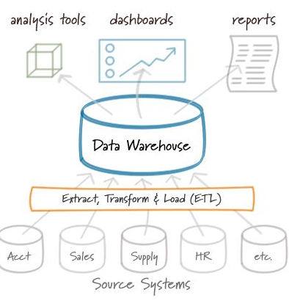
What is a Data Warehouse
A data warehouse is a large, centralized repository for storing and managing large amounts of data from various sources.
Unlike traditional databases, which are designed for transactional processing and have limited capabilities for analyzing data, data warehouses are optimized for data analysis and reporting. They store structured and semi-structured data, i.e., SQL (Structured Query Language) and NoSQL (Not Only SQL)
NOTE: Data Warehouse are OLAP solution
Examples of Data warehouse
Google BigQuery
Amazon Redshift
Microsoft Azure Synapse Analytics
Snowflake

Slide 5
Google BigQuery
Serverless data warehouse
There are no servers to manage or database software to install
Software as well as infrastructure, including
scalability and high-availability
Built-in features like
machine learning
geospatial analysis
business intelligence
BigQuery maximizes flexibility by separating the compute engine that analyzes your data from your storage
For more: Link

Slide 6
Partition Vs Clustering

Slide 7
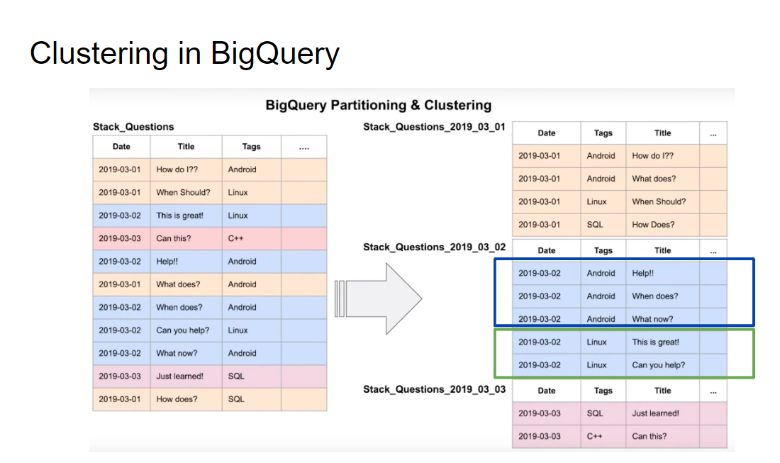
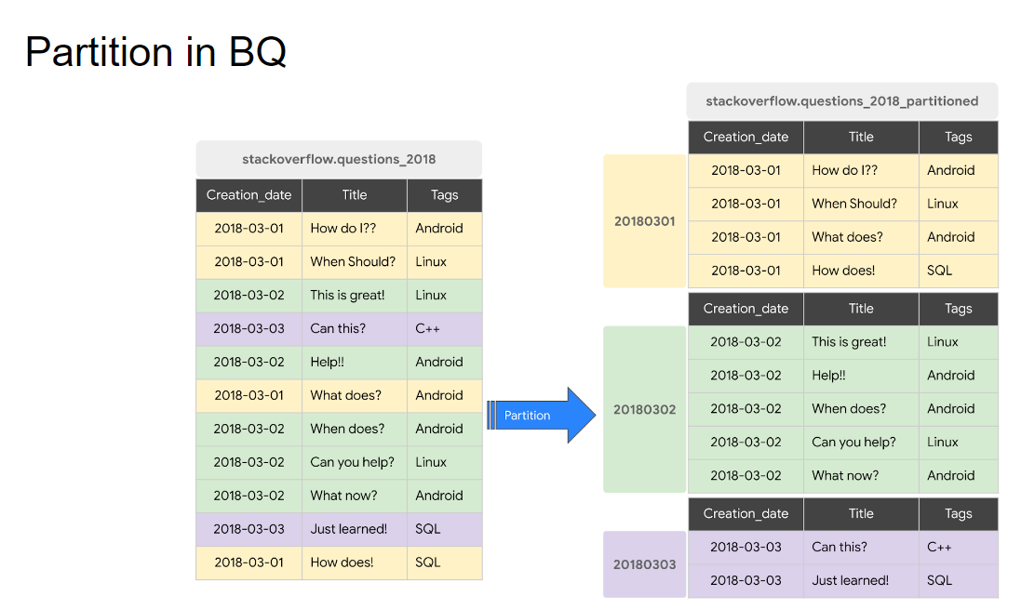

Slide 8
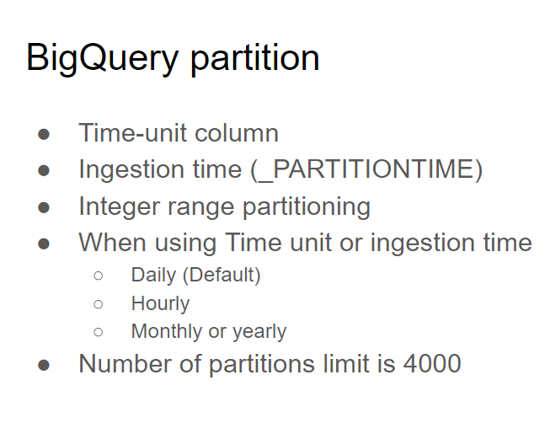
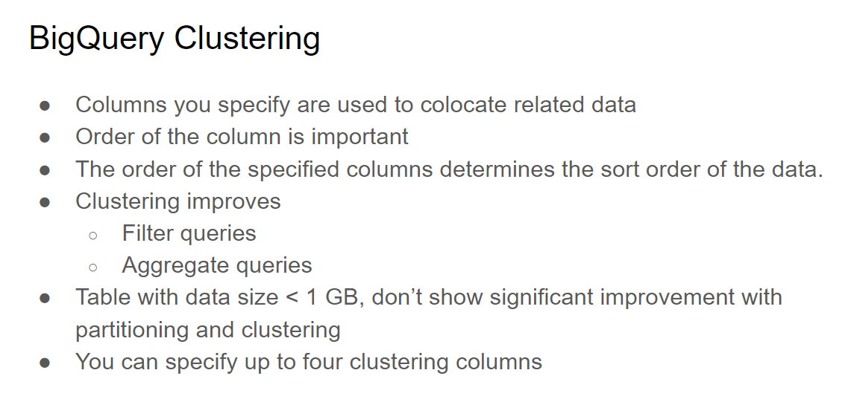
Resource: https://cloud.google.com/bigquery/docs/partitioned-tables
Resource: https://cloud.google.com/bigquery/docs/clustered-tables

Slide 9
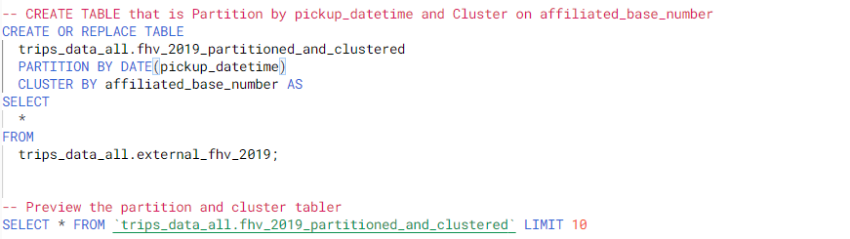
Partition and Clustering Syntax

Slide 10
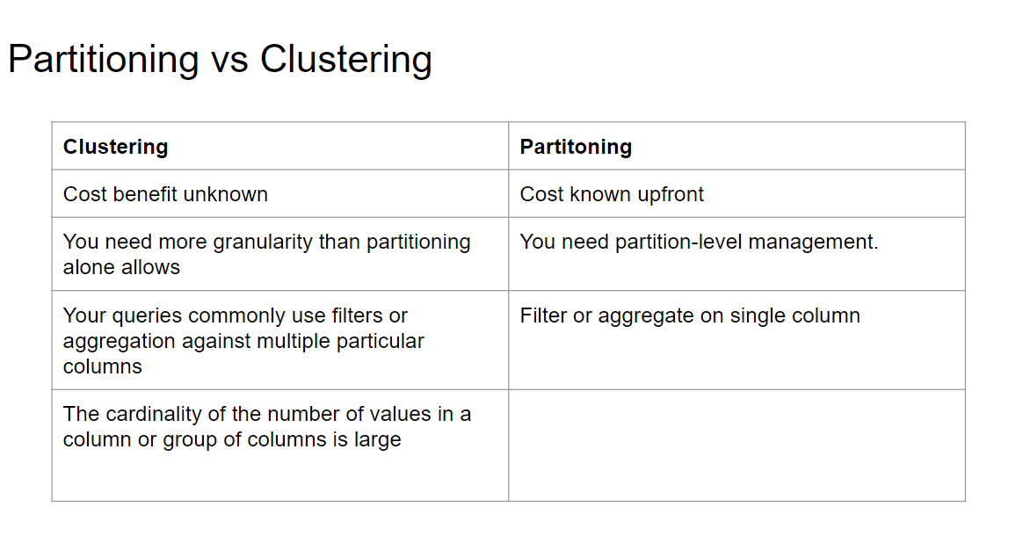

Slide 11
BigQuery-Best Practice
Cost reduction
Avoid SELECT *
Price your queries before running them
Use clustered or partitioned tables
Use streaming inserts with caution
Materialize query results in stages
Query performance
Filter on partitioned columns
Denormalizing data
Use nested or repeated columns
Use external data sources appropriately
Don't use it, in case u want a high query performance
Reduce data before using a JOIN
Do not treat WITH clauses as prepared statements
Avoid oversharding tables

Slide 12
Google BigQuery ML

Slide 13
BigQuery ML
BigQuery ML is a tool provided by Google Cloud's BigQuery service that enables users to build and deploy machine learning models using SQL. It allows users to efficiently train and evaluate models on large datasets within BigQuery, without moving data to external systems.
Key Feature
Target audience Data analysts, managers
No need for Python or Java knowledge
No need to export data into a different system
Pricing
Free
10 GB per month of data storage
1 TB per month of queries processed
ML Create model step: First 10 GB per month is free
Resouces: https://cloud.google.com/bigquery-ml/docs

Slide 14
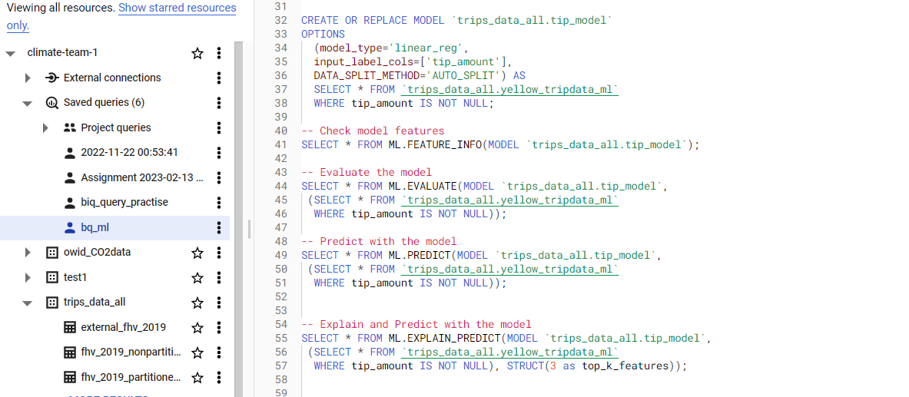
BigQuery ML Code Sampler

